Slide 1



OECD Economic Survey of Romania
Keeping up reform efforts to support economic convergence
Bucharest
16 March 2026
https://oe.cd/romania
@OECDeconomy
@OECD

Slide 2
Romania has achieved strong convergence towards OECD average living standards
Real GDP per capita
USD
Note: US dollars are expressed in constant purchasing power parities, with reference year 2020. OECD Central and Eastern Europe is an unweighted average of Czechia, Hungary, Poland, the Slovak Republic and Slovenia.
Source: OECD National Accounts database.

Slide 3
Inflation pressures remain elevated, though wage growth has decelerated
Price and wage growth
Year-on-year, %
Note: Consumer price inflation refers to monthly harmonised headline inflation.
Source: OECD Economic Outlook database.

Slide 4




GDP growth is expected to recover gradually
2024
2025
2026
2027
Real GDP growth, %
0.9
0.7
1.0
2.2
Unemployment rate, %
5.4
6.1
6.1
5.7
Consumer price inflation, %
5.6
7.3
6.6
3.0
Fiscal balance, % of GDP
-9.3
-8.3
-6.3
-6.3
Source: OECD Economic Outlook database.

Slide 5


Addressing fiscal challenges

Slide 6
Fiscal sustainability requires further fiscal consolidation beyond 2026
General government debt, Maastricht definition
% of GDP
Note: In the “Current path” scenario, the structural primary deficit is based on the OECD Economic Outlook database until 2027, and the OECD Long-Term Model thereafter, adding the projected changes in ageing costs based on the EU Ageing Report 2024. The “Prudent path under fiscal rules” scenario assumes additional consolidation of the structural primary balance relative to the “Current path” trajectory, in line with Romania’s medium-term fiscal plan agreed with the European Union. This corresponds to further fiscal consolidation of 4.25% of GDP between 2027 and 2031 compared to the “Current path”, leading to a surplus of 1.7% of GDP by 2031, which is maintained thereafter. The 2025 and 2026 numbers for government debt are estimates.
Source: OECD calculations based on OECD Economic Outlook database and Long-Term Model; EU Ageing Report 2024.

Slide 7
Improving spending efficiency would help ensure fiscal sustainability and support resilient growth
General government spending and revenue
% of GDP
Source: OECD Economic Outlook database.

Slide 8
Tax compliance needs to be strengthened through improved digitalisation and tax audits
Value-added tax compliance gap
2024 or latest available, % of estimated total value-added tax liability
Note: The value-added tax compliance gap measures the difference between the value-added tax revenue that would be collected if there were full compliance and actual value-added tax receipts. It covers revenues lost due to fraud and evasion, insolvencies, administrative errors and legal tax optimisation.
Source: European Commission (2024), Directorate-General for Taxation and Customs Union, value-added tax gap in the EU-2024 report.

Slide 9

Strengthening competitiveness

Slide 10
Global integration advances but domestic firms could be better integrated into global supply chains
Goods exports by type of ownership of the trading enterprises
2023, % of total exports
Note: EU is an unweighted average. Data exclude goods exports from unknown owners.
Source: Eurostat.

Slide 11
Further streamlining business licensing would foster business dynamism
Product market regulation
2023/2024, Index, scale 0-6 from least to most restrictive
Note: Indicator value from 0 to 6, which increases in the stringency of the regulatory environment. OECD and EU are unweighted averages.
Source: OECD-World Bank Group Product Market Regulation database.

Slide 12
Enhancing teacher training and modernising curricula with a stronger focus on digital skills could boost education outcomes
Enrolment rates
2023 or latest available, %
Note: OECD is an unweighted average. Enrolment rate is the total number of students of the official age group for a given level of education who are enrolled in any level of education, expressed as a percentage of the corresponding population.
Source: World Bank-UNESCO Institute for Statistics Education Survey.

Slide 13

Promoting higher workforce participation

Slide 14
Healthier ageing would help workers stay productive and employed for longer
Expected healthy life years at age 50
2023 or latest available
Note: The indicator of healthy life years measures the number of remaining years that a person at age 50 is expected to live without any severe or moderate health problems.
Source: Eurostat.

Slide 15
Stronger return-to-work incentives after giving birth would raise women’s employment
Women’s employment rate
2024, % of 15-64 year olds
Source: OECD Labour Force Statistics database.

Slide 16
Improving access to quality vocational education and job-relevant training can boost employment of young people
Share of 15-29 year olds not in employment, education or training
2024 or latest
Source: OECD Education at a Glance 2024 database.

Slide 17

Enhancing resilience to climate change

Slide 18
Exposure to climate change is high, especially in relation to floods, heatwaves and droughts
Share of land exposed to river flooding with a 100-year return period
2022, %
Note: A return period is the average or estimated time that a specific hazard is likely to recur.
Source: OECD River flooding exposure dataset.

Slide 19
Improvements in water infrastructure and wastewater treatment would reduce strain on freshwater resources
Water exploitation index
2023, % of renewable freshwater resources
Note: The water exploitation index provides a measure of total water consumption as a percentage of the renewable freshwater resources available.
Source: European Environment Agency.

Slide 20
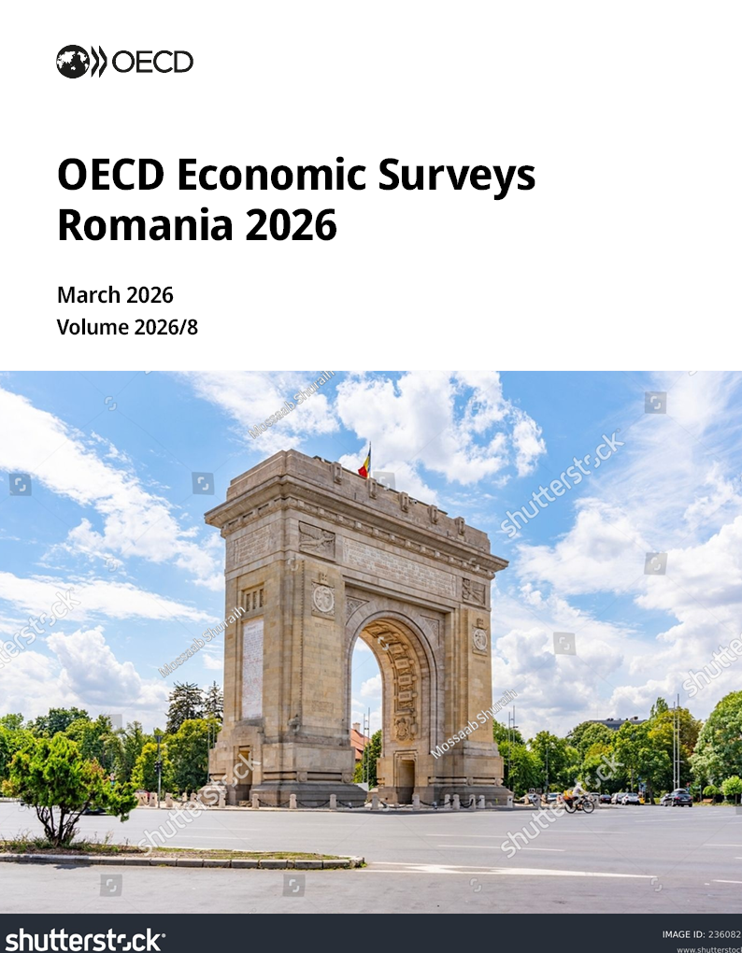


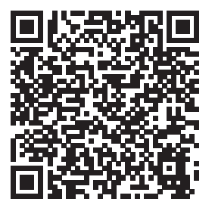
For more information
OECDEconomy
OECD
https://oe.cd/romania
Disclaimers:
The statistical data for Israel are supplied by and under the responsibility of the relevant Israeli authorities. The use of such data by the OECD is without prejudice to the status of the Golan Heights, East Jerusalem and Israeli settlements in the West Bank under the terms of international law. This document and any map included herein are without prejudice to the status of or sovereignty over any territory, to the delimitation of international frontiers and boundaries and to the name of any territory, city or area.

